Slide 1
Jarosław Stadnicki
developer, blogger, leader jaroslawstadnicki.pl

Slide 2

Is there any news
pet project
http://www.wallpapersxl.com/wallpaper/1920x1080/toshiba-laptop-nature-spectacular-green-field-high-definition-hd-2060250.html

Slide 3
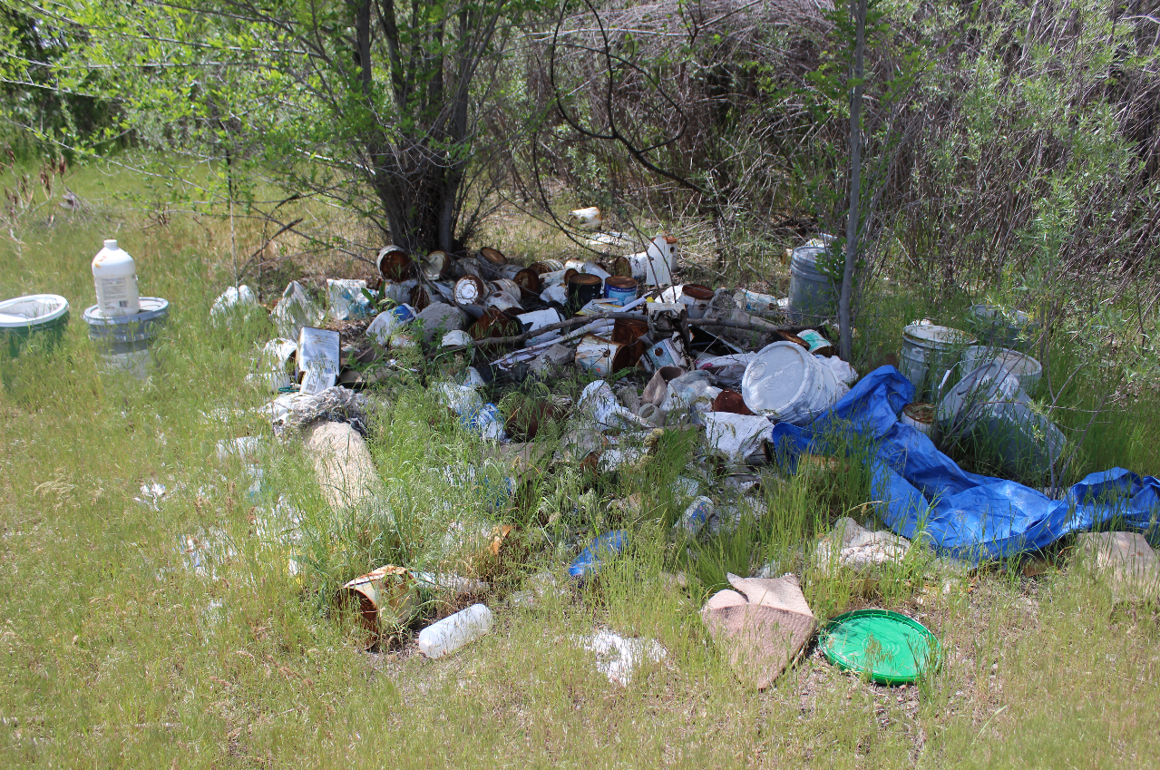
About
About
Technology
Self development
Demo?

Slide 4
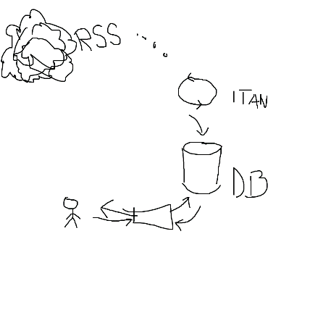
About project: MVP1
RSS - Really Simple Syndication uses a family of standard web feed formats to publish frequently updated information: blog entries, news headlines. An RSS document includes full or summarized text, and metadata, like publishing date and author's name. (wikipedia)

Slide 5
About project: MVP1
Rss reader (kind of works)

Slide 6
About project: MVP2
Rss reader (kind of works)
Best news of a (near future)
day, week, month
friends
topic

Slide 7
About project: MVP3
Rss reader (kind of works)
Best news of a (near future)
day, week, month
friends
topic
Social agregator (far future)

Slide 8
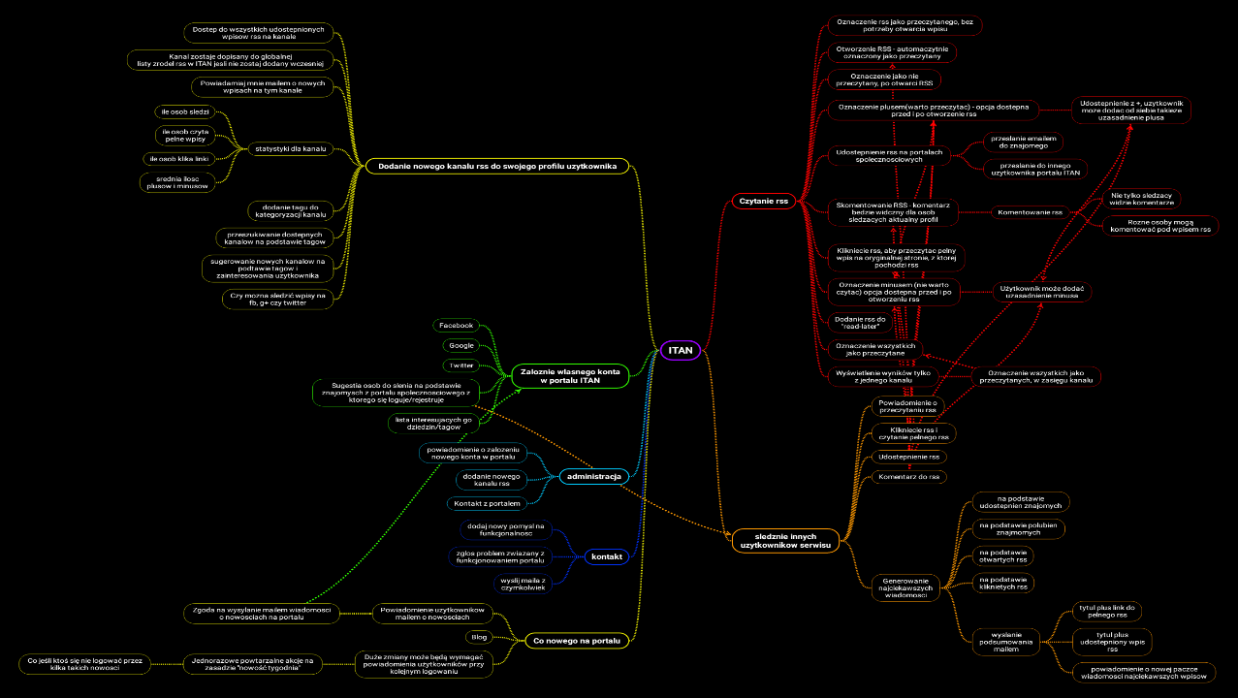
About project: ideas

Slide 9
Why?
Google reader is no more

Slide 10
Why?
Google reader is no more
Idea

Slide 11
Why?
Google reader is no more
Idea
Daj się poznać

Slide 12
Why?
Google reader is no more
Idea
Daj się poznać
Practice

Slide 13
Why?
Google reader is no more
Idea
Daj się poznać
Practice
Glory, cash, lazers

Slide 14

Technology
What ever suits you
Whatever will do the job
Whatever you wants

Slide 15
http://www.wallpapersxl.com/wallpaper/1920x1080/toshiba-laptop-nature-spectacular-green-field-high-definition-hd-2060250.html

Slide 16

Technology: lessons learnt
ToBeImplemented-v1.zip
ToBeImplemented-v2.zip
ToBeImplemented-v3.zip
ToBeImplemented-v4.zip
https://bitbucket.org/jstadnicki/tobeimplemented-v5

Slide 17
Technology: backend guy tools
C#
Asp .Net MVC
MsSql
jQuery
Angular
Entity Framework
Visual Studio
Resharper
Team City – this is a lie
NUnit, OpenCover
Azure
Exceptionless
Fluentscheduler – to be replaced

Slide 18
Technology: two ways
Newest
Sharpest
Coolest
Stack Overflow best friend
Proven to work
Stable
Reliable
Borring?

Slide 19
Self development: Full Stack Developer
C#
jQuery
CSS
Unit tests

Slide 20
Self development: Full Stack Developer
Backend developer
Frontend developer
Build manager
Database manager
Quality Engineer
Security Specialist
Project Manager
Business Analyst
Marketer
Social Media Presenter
UX
Designer
Scaling specialist
Money guy
Mobile developer

Slide 21
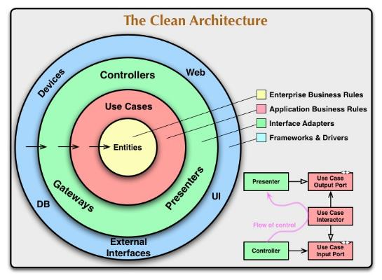
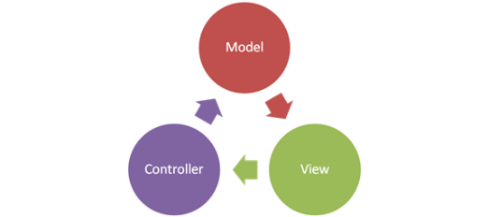
Architecture (wish)

Slide 22
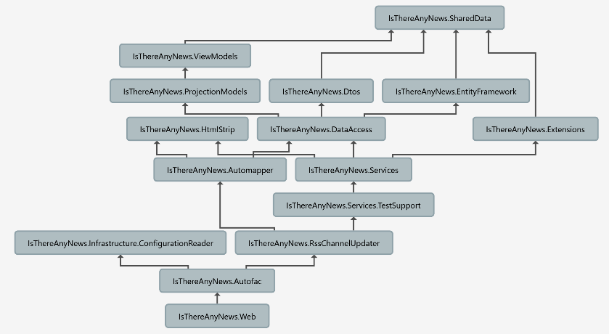
Architecture (actual)

Slide 23
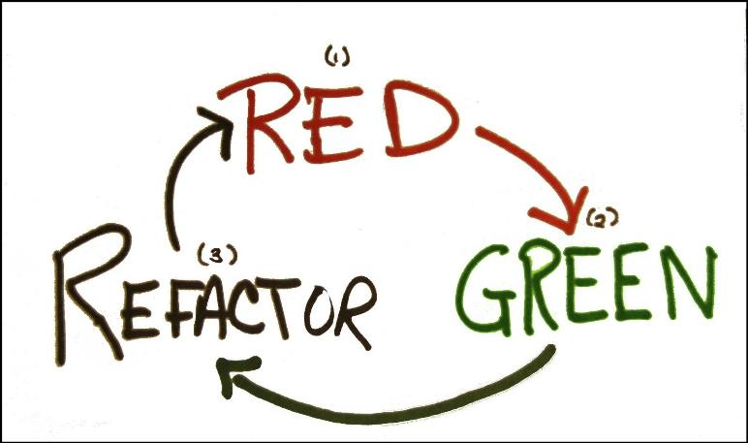
Tests: magic cycle

Slide 24
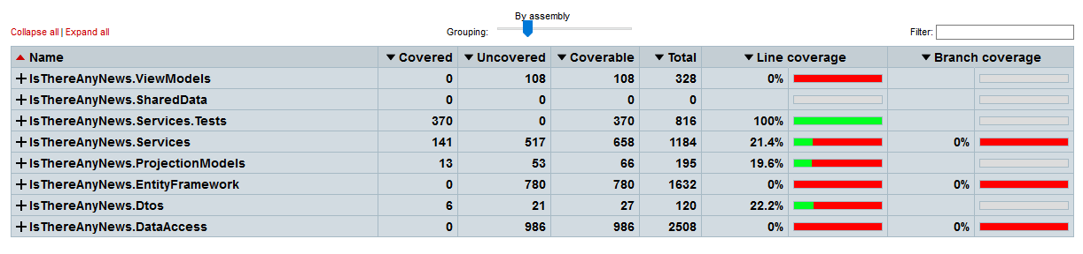
Tests: real life

Slide 25
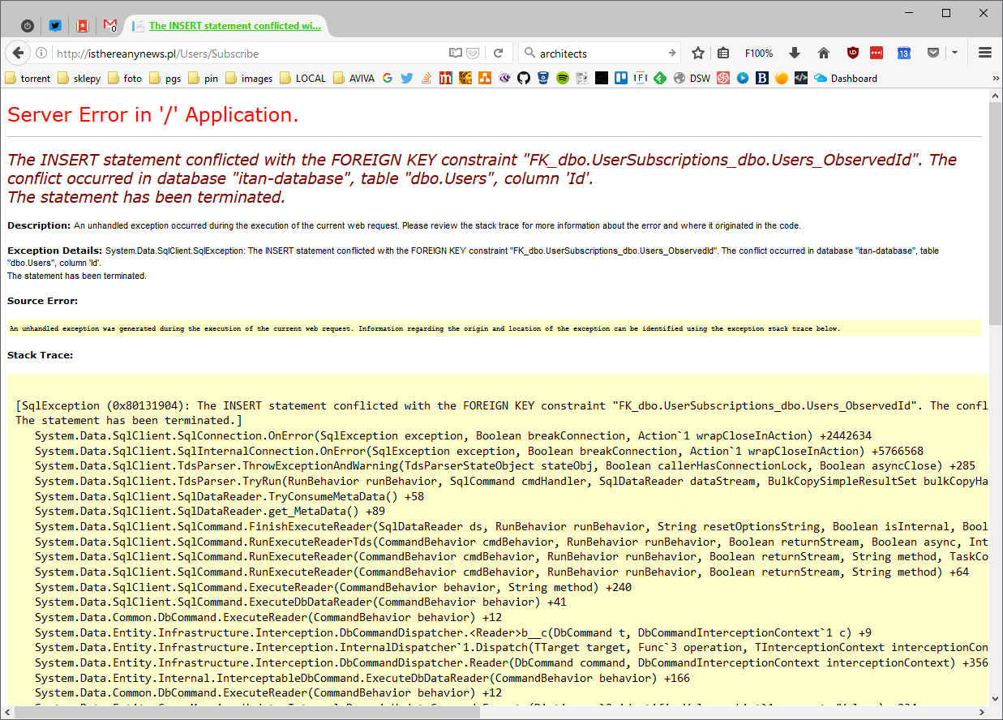
Tests: real life

Slide 26

Performance

Slide 27
Experience
f(x)=x

Slide 28
Motivation
f(x)=sin(x)

Slide 29
Else
f(x)

Slide 30
Questions?

Slide 31
Is there any news
https://github.com/jstadnicki/isthereanynews
http://isthereanynews.pl/
@isthereanynews

Slide 32
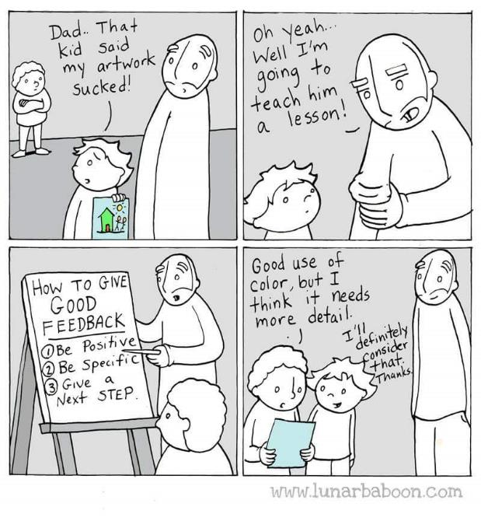
Feedback
jaroslaw.stadnicki@gmail.com

Slide 33
Jarosław Stadnicki
jaroslaw.stadnicki@gmail.com
jaroslawstadnicki.pl
@j_stadnicki

Slide 34
❤
thank you

